Slide 1
Road Map
Evolution of Technology
Types of Data
Big Data - Definition Aspect
Big data Vs Not Big data
Challenges of big data

Slide 2
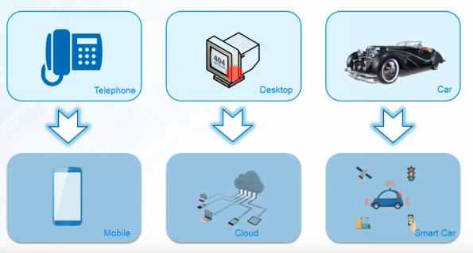
Evolution of Technology

Slide 3
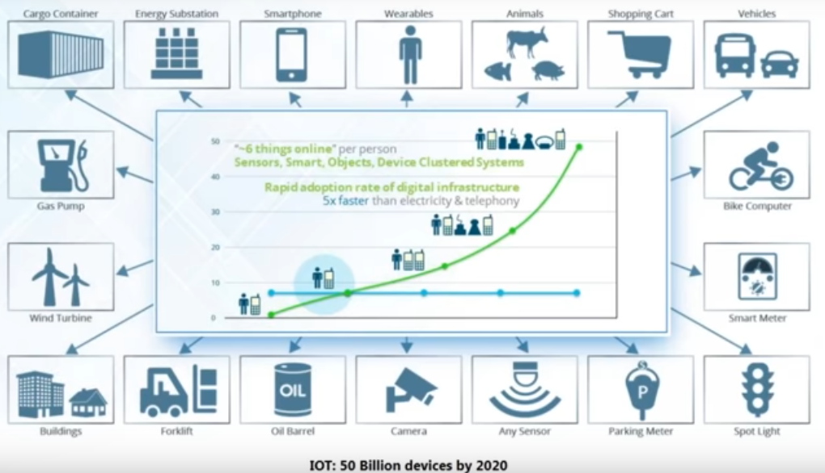
Internet of Things

Slide 4
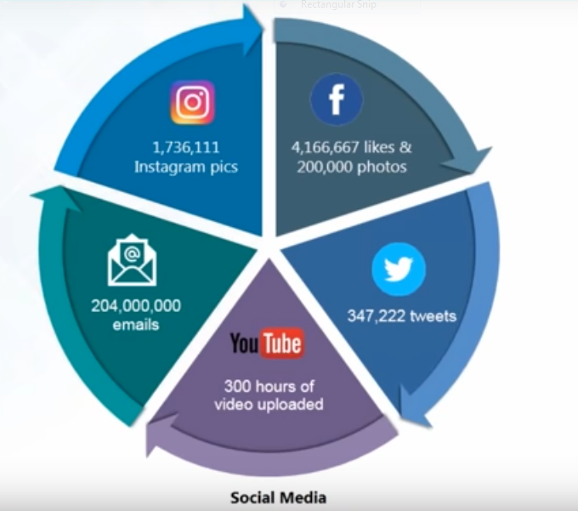
Social Media Usage

Slide 5
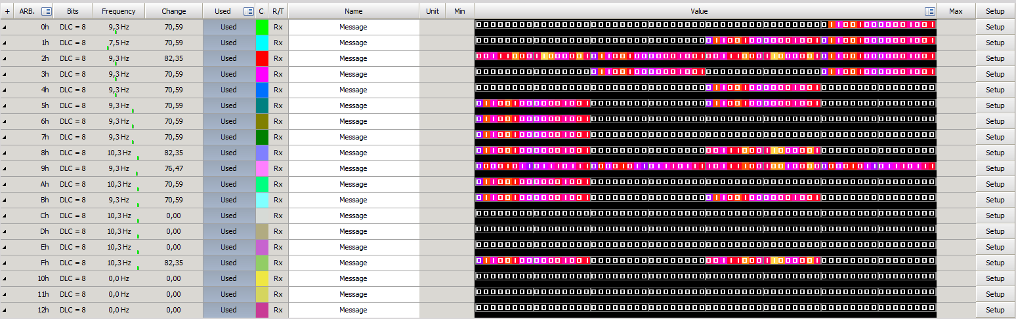
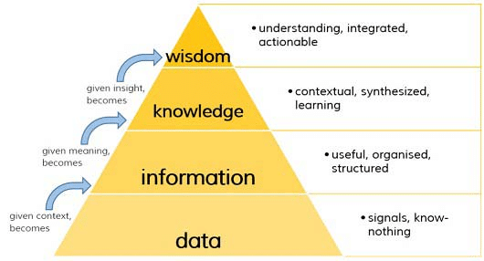
Classification of Digital Data

Slide 6
Classification of Digital Data

Slide 7
Structured data
When do we say that the data is structured??
Sources of structured data

Slide 8
Working with structured data
Insert/update/delete
Indexing
Transaction processing
Security
Scalability

Slide 9
Semi-structured data
It does not conform to the data models that one typically associates with relational databases or any other form of data tables
It uses tags to segregate semantic elements

Slide 10
Sources of semi-structured data

Slide 11
Unstructured data
Does not conform to any predefined data model
The structure can be unpredictable.

Slide 12
Sources of unstructured data

Slide 13
How to deal with unstructured data?

Slide 14
Inclass#exercise

Slide 15
Solution

Slide 16
Let’s Discuss
Why email in unstructured category?
Where should we put CCTV footage?

Slide 17
You are at city shopping mall. You see few people are browsing the items. Some of them are looking for discounts. Some of them are filling feedback form. Few people are at billing counter. You may consider other things and events happening in this scenario. Think for while on the different types of data generated. Mention each of them with proper logic

Slide 18
You are at university library. You see few students browsing through the library catalog on kiosk. You see the working of librarians and other staff to issue/return books, magazines, and journals. Few students are using the e-library service, too. Which type of data is generated in this scenario? Support your answer by considering big data

Slide 19
Big Data – Definitional Aspects

Slide 20
Characteristics of Big data
Gartner’s 3V casted by Douglas Laney in 2001
Volume , Velocity and Variety
IBM’s 4V casted by Zikopoulos
Volume , Velocity , Variety and Veracity
Yuri Demchenko’s 5V
Volume , Velocity , Variety , Veracity and Value
Microsoft’s 6V
Volume , Velocity , Variety , Veracity , Value and Visibility

Slide 21
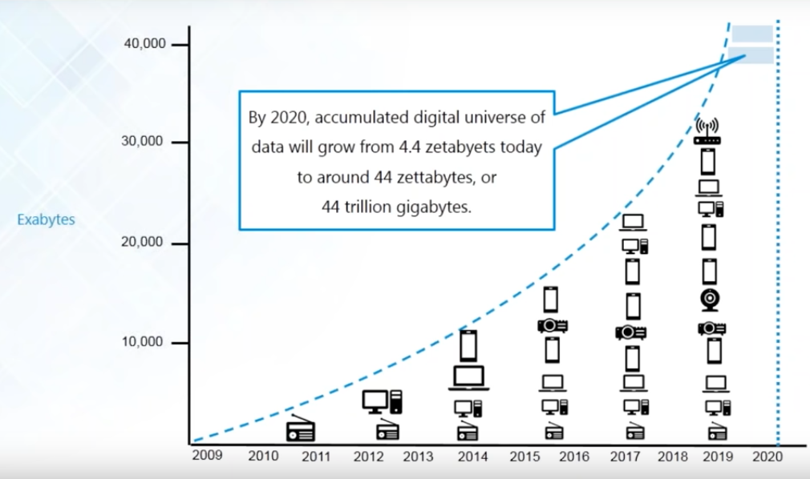
Volume

Slide 22
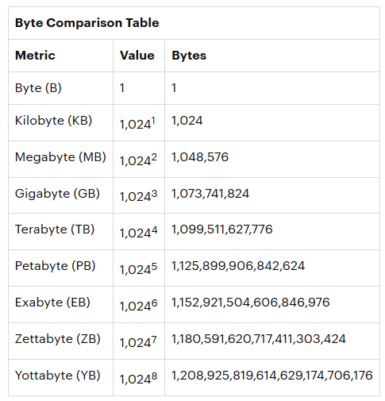

Slide 23
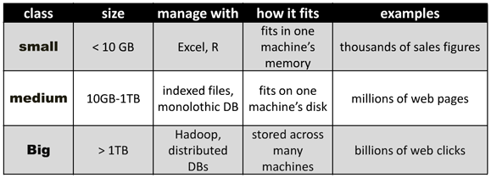

Slide 24
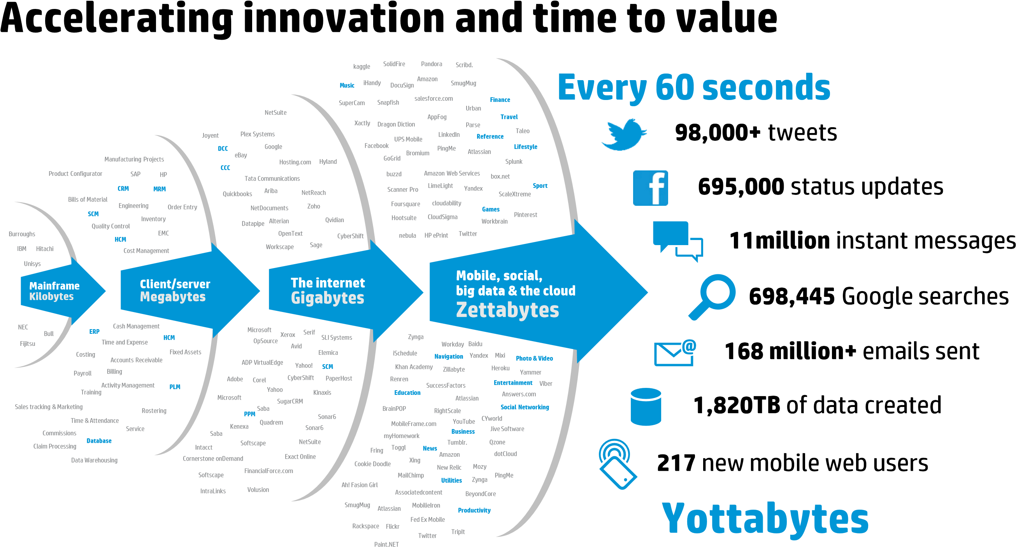
Velocity
Taken from : Hewlett-Packard Development Company “truths and myths about big data”,2013

Slide 25
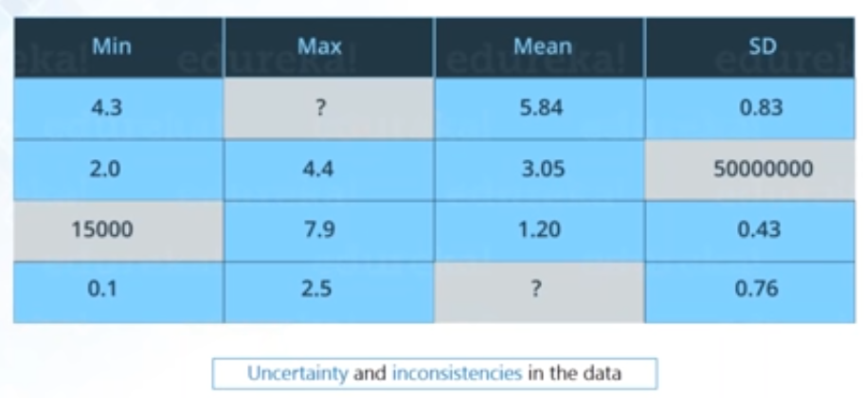
Veracity

Slide 26
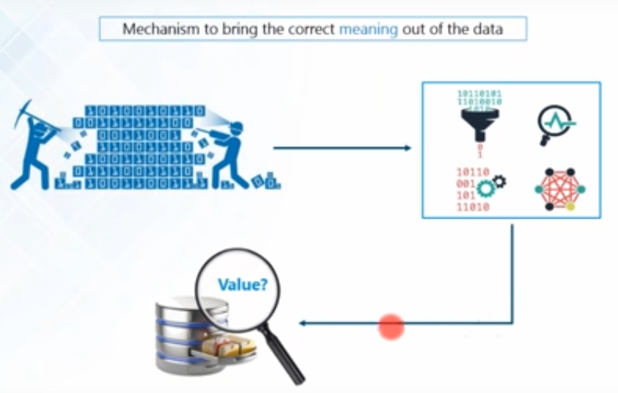
Value

Slide 27
What is big data about?
Answers are often “too big to ….”
Load into memory……..…Store on a hard drive…….…Fit in a standard database
“Fast changing”………..Not just relational
“Digital breadcrumbs” left behind (communication transactions..)—Hard little data particles left behind as people go about their daily lives
Open web data/social media data (facebook, twitter, blogs, online news, videos….)
Remote sensing (satellite, meters…)

Slide 28
What is big data about - and not about?
“Big Data is not about the data” (Gary King)
Institute for social science ,Harvard university
It’s about the analytics—the insights gleaned from the data; and the necessary capacities to do so—human, technological
One step further: it’s about knowledge: getting near to the ‘true’ meaning of a facebook status update;
It’s about sharing and diffusion – visualizations

Slide 29
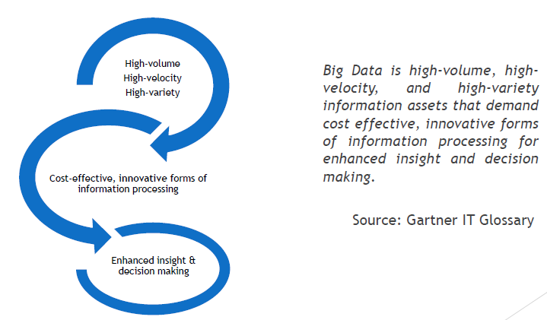
Big data Definition

Slide 30
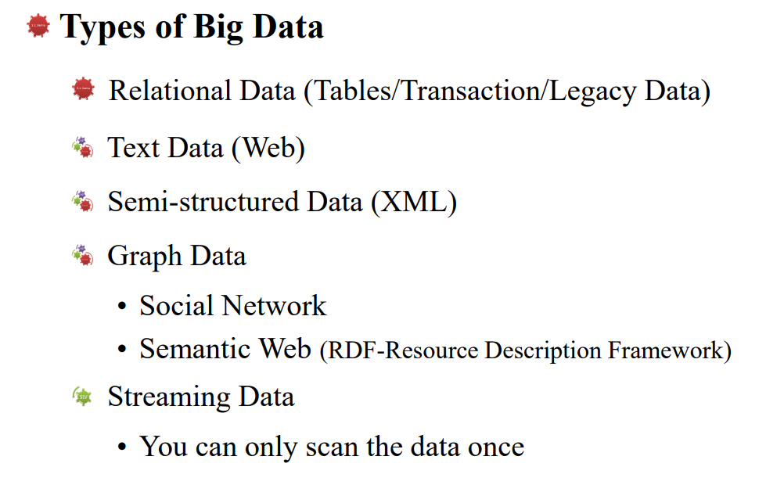
Types of Big Data

Slide 31
Challenges with Big data

Slide 32
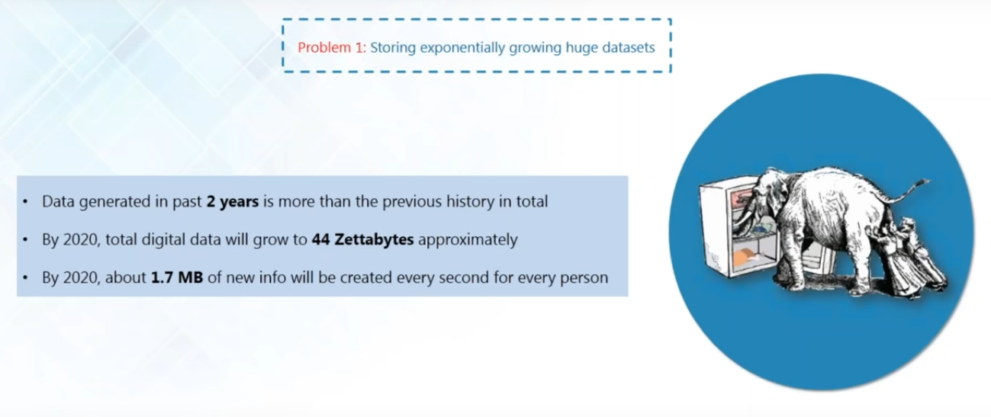

Slide 33
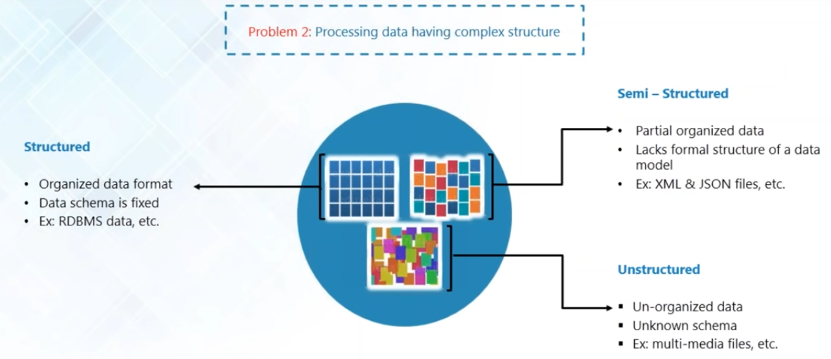

Slide 34
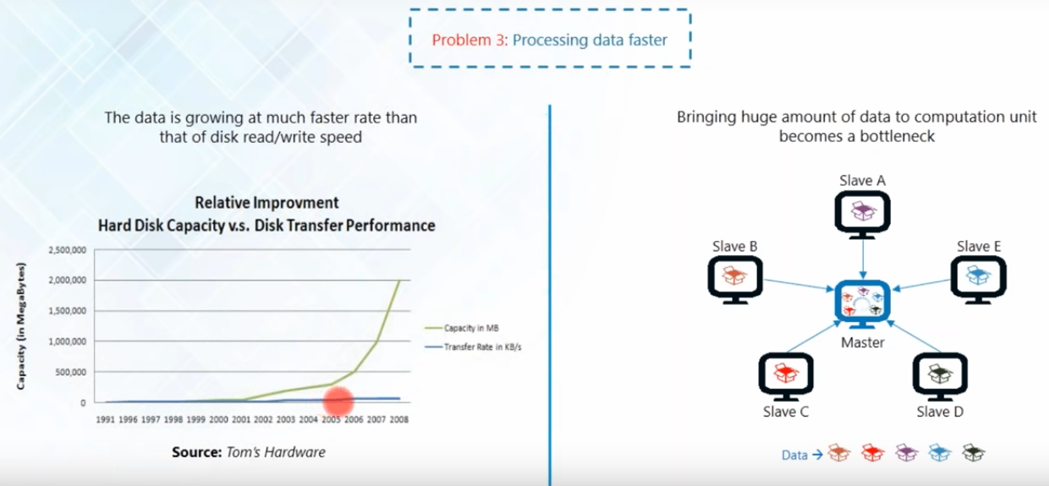

Slide 35
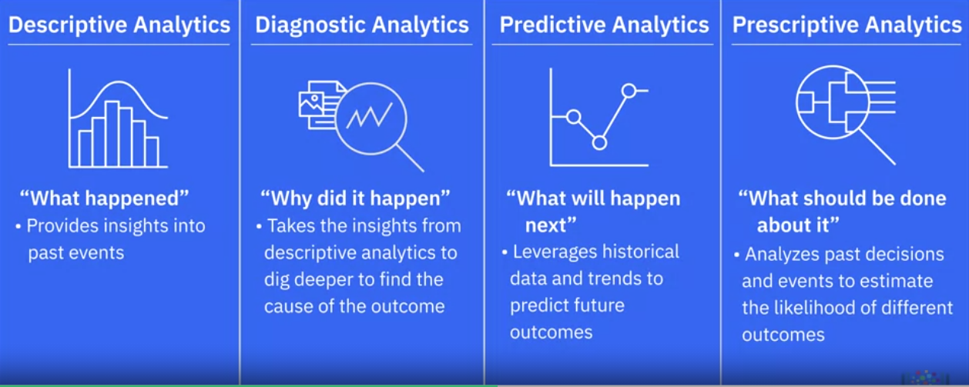
Classification of Data Analytics

Slide 36
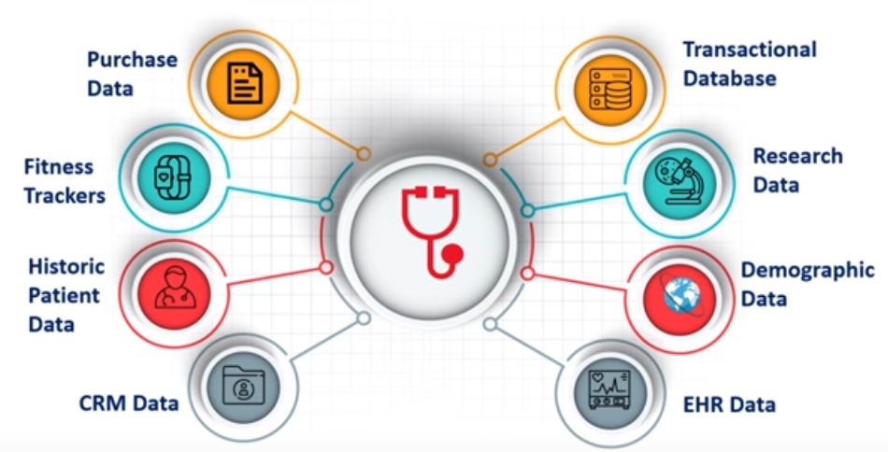
Big data Analytics-Case studies
Healthcare

Slide 37
Traditional Vs Big data Approach
OLTP: Online Transaction Processing
DBMSs
OLAP: Online Analytical Processing
Data Warehousing
RTAP: Real-Time Analytics Processing
Big Data Architecture & Technology

Slide 38
Use cases
Online money transfer
Iterative computations
Joins and aggregations computations
Ad-hoc computations
Customer churn analytics
Customer segmentation for optimized offers
Processing of large amount of small files
Security applications

Slide 39
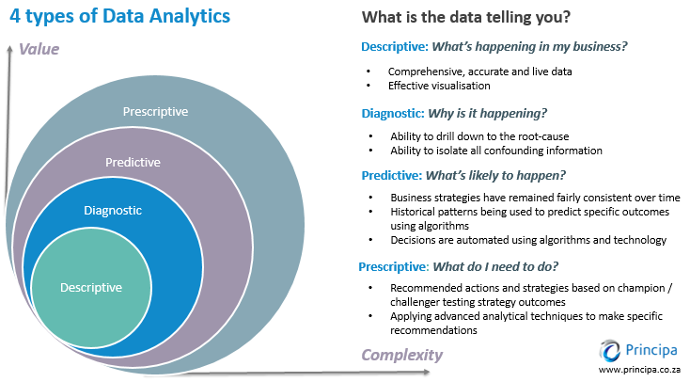
Data analytics

Slide 40
Use cases
Use Case: A Company wants to analyse the effective utilization of office and lab resources.
Use Case: A E-commerce company wants to identify the reason behind the sudden fall in sales during last month for a particular product.
Use Case: The PAY-PAL company wants to protect their clients against fraudulent transactions.
Use case: An airline company wants to maximize the airline profit.

Slide 41
RDBMS vs. Hadoop
RDBMS | Hadoop
Traditional row-column based DB, used for data storage, manipulation and retrieval. | An open-source software used for storing data and running applications or processes concurrently.
Structured data is mostly processed. | Both structured and unstructured data is processed.
Best suited for OLTP environment. | Best suited for BIG data.
Less scalable than Hadoop. | Highly scalable.
Data normalization is required. | Data normalization is not required.
Stores transformed and aggregated data. | Stores huge volume of data.
No latency in response. | Some latency in response.
Data schema of RDBMS is static. | Data schema of Hadoop is dynamic.
High data integrity available. | Low data integrity available than RDBMS.
Cost is applicable for licensed software. | Free of cost, as it is an open source software.

Slide 42
RDBMS vs. MapReduce
 | Traditional RDBMS | MapReduce
Data size | Gigabytes | Petabytes
Access | Interactive and batch | Batch
Updates | Read and write many times | Write once, read many times
Transactions | ACID | None
Structure | Schema-on-write | Schema-on-read
Integrity | High | Low
Scaling | Nonlinear | Linear

